Slide 1
A Lane Detection, Tracking and Recognition System for Smart Vehicles (LTRSV)
Batch No: 19CSEA010
Team Members
A. Bharathi Devi(16K61A0501)
G. Siva Jyothi (16K61A0541)
K. Ethish Kumar (17K65A0501)
Ch. Manoj Sai(16K61A0517)
Supervisor
Dr.N.Krishnaraj,M.E,Ph.D
Professor,CSE Department,
Sasi Institute of Technology &Engineering

Slide 2
List of Contents
Abstract
Contributions
Module split up
Gantt chart
Detailed design
Hardware/Software requirements
Software Implementation
Experimental result
Comparison
Conclusion
References/Bibliography

Slide 3
Abstract
Introduce an approach to detect information about lane and vehicle for the driver assistance system, or the lane tracking and vehicle detection system. Most previous research works could only detect the lanes or vehicles separately. However, the combination of lane information and vehicle information is able to support the driver assistance system and to improve the reliability of results. For the Lane detection, tracking and recognition system for smart vehicles (LTRSV), it must detect the frontal lanes and discover the vehicles around a test vehicle. Therefore, a vision system is utilized including two cameras, one is fixed in front side top and another one is fixed in inside the vehicle to analyze driver facial expression.

Slide 4
Contributions
SNO | Start Time | End Time | Topic |  | Project Associates
 |  |  |  |  | 16K61A0501 | 16K61A0541 | 17K65A0501 | 16K61A0517
1 | 21/11/2019 | 05/12/2019 | Literature Survey |  |  |  |  | 
2 | 06/12/2019 | 12/12/2019 | Problem Formulation |  |  |  |  | 
3 | 13/12/2019 | 21/12/2019 | Requirements Identification |  |  |  |  | 
4 | 22/12/2019 | 10/01/2020 | Design | Data flow |  |  |  | 
 |  |  |  | System Architecture |  |  |  | 
 |  |  |  | Use Case |  |  |  | 
 |  |  |  | Class |  |  |  | 
 |  |  |  | StateChart |  |  | 
 |  |  |  | Activity |  |  | 
 |  |  |  | Sequence |  |  |  | 
 |  |  |  | Collaboration |  |  |  | 
 |  |  |  | Component |  |  | 
 |  |  |  | Deployment |  |  |  | 
5 | 11/01/2020 | 28/02/2020 | Implementation | Drowsiness |  |  |  | 
 |  |  |  | Lane Detection |  |  |  | 
 |  |  |  | Vehicle Detection |  |  |  | 
6 | 29/02/2020 | 06/03/2020 | Testing |  |  |  |  | 
7 | 07/03/2020 |  | Documentation |  |  |  |  | 

Slide 5
Module split-up
Drowsiness Detection
Lane detection
Vehicle detection

Slide 6
Drowsiness Detection
To detect the driver facial expression because if the driver may be feel sleepy at that time our drowsiness detector will detect and alert the driver with voice assistant otherwise there is a chance to occur accidents, And these always keep monitor the facial expressions of the driver until he reaches the destination for drowsiness detection we can use Facial Expression Recognition Using Support Vector Machine.

Slide 7
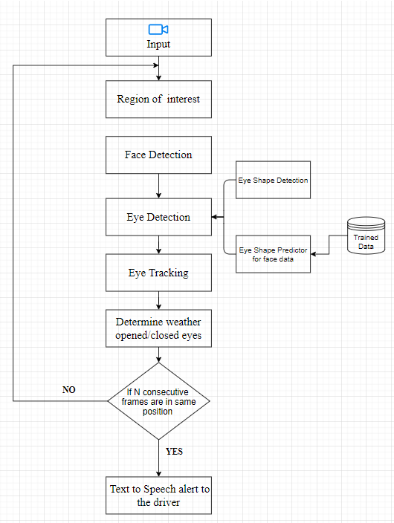
Drowsiness Detection
Work Flow Diagram

Slide 8
Lane detection
The results of lane edge detection play an important role in feature-based lane detection. The complicated conditions of road make the correct edge detection of lane markings become very challenging. In order to get an ideal edge of lane markings in road image, a method of lane edge detection based on Canny algorithm is proposed. Firstly according to the importance in lane markings recognition, the road image is divided into three regions. Only the regions with useful information are processed. Then by the features of gray distribution and lane markings width, some noises are removed from the image. Using the shape features of lane markings, the lane edges are detected based on Canny algorithm. Finally by use of the Hough transform technique lane detection is achieved.

Slide 9
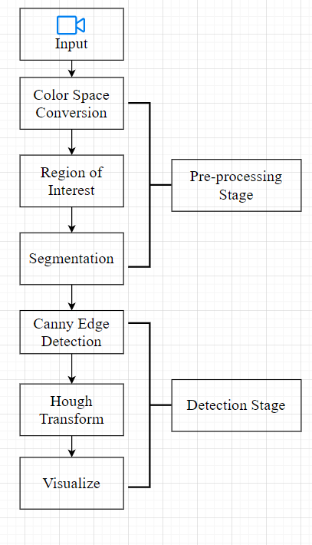
Lane Detection
Work Flow Diagram

Slide 10
Vehicle detection
Vehicle detection is a technology which its aim is to locate and
show the vehicle size in digital images. In this technology,
vehicles are detected in presence of other things like trees and
buildings.It has an important role in many computer vision
applications such as vehicle tracking, analyzing the traffic scene
and efficient traffic management.These Vehicle detection is
implemeted based on “Haar like cascade classifier”.

Slide 11
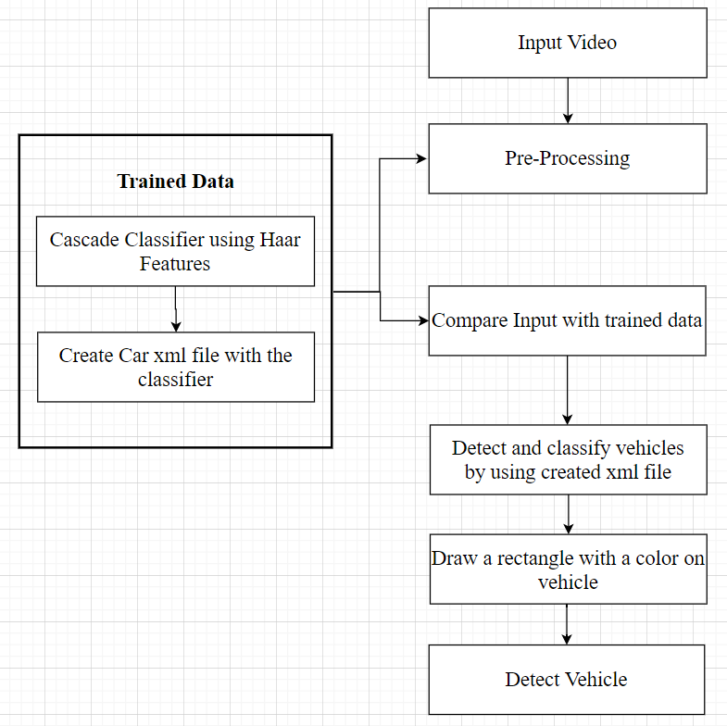
Vehicle Detection
Work Flow Diagram

Slide 12
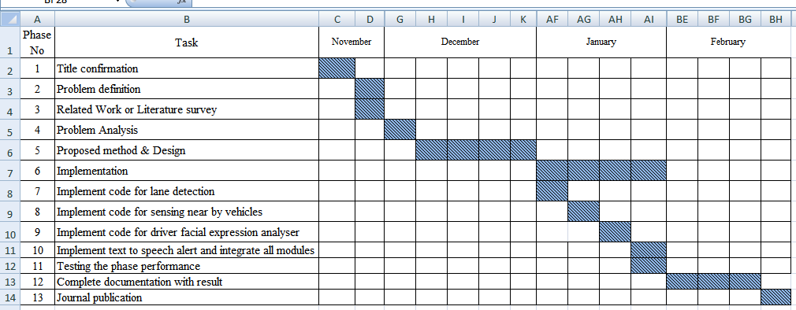
Gantt chart
For full Gantt chart:https://drive.google.com/open?id=0B5CCyMjZT9O0MVc3bjBJVUxHWmI0WnotRkR6bzlobExsaDlZ

Slide 13
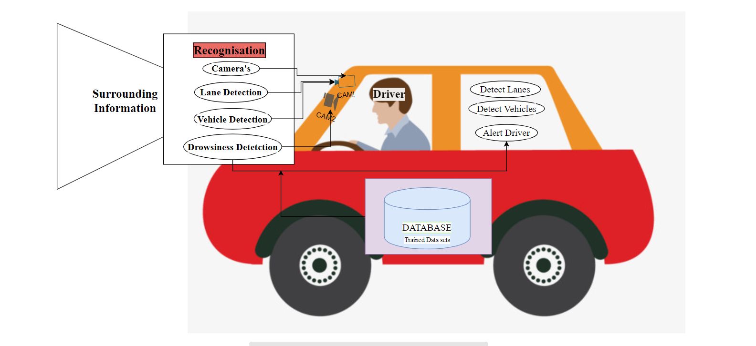
Detailed design
System Architecture

Slide 14
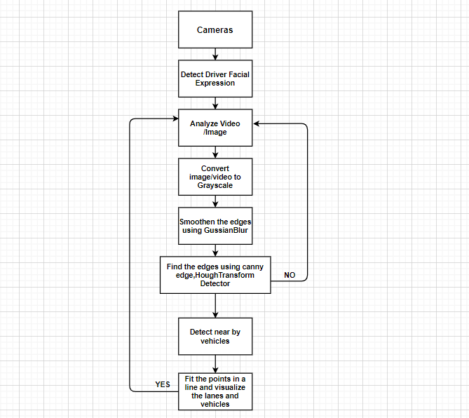
Detailed design
Data flow diagram

Slide 15
Software requirements
Python 3*
Opencv 4
Numpy or Scipy
Matplotlib
Dlib

Slide 16
Hardware requirements
Minimum System Requirements
Processors: Intel Atom processor or Intel Core™ i3 processor.
Disk space: 1 GB.
RAM: 512MB
Operating systems: Windows* 7 or later, macOS, and Linux.
Note :- Depending on the operating system's required libraries are may changed.

Slide 17
Implementation
Drowsiness Detection
(lStart, lEnd) = face_utils.FACIAL_LANDMARKS_68_IDXS["left_eye"]
(rStart, rEnd) = face_utils.FACIAL_LANDMARKS_68_IDXS["right_eye"]
cap=cv2.VideoCapture(0)
flag=0
while True:
ret, frame=cap.read()
frame = imutils.resize(frame, width=450)
gray = cv2.cvtColor(frame, cv2.COLOR_BGR2GRAY)
subjects = detect(gray, 0)
for subject in subjects:
shape = predict(gray, subject)
shape = face_utils.shape_to_np(shape)
leftEye = shape[lStart:lEnd]
rightEye = shape[rStart:rEnd]
leftEAR = eye_aspect_ratio(leftEye)
from scipy.spatial import distance
from playsound import playsound
from imutils import face_utils
import imutils
import dlib
import cv2
def eye_aspect_ratio(eye):
A = distance.euclidean(eye[1], eye[5])
B = distance.euclidean(eye[2], eye[4])
C = distance.euclidean(eye[0], eye[3])
ear = (A + B) / (2.0 * C)
return ear
thresh = 0.25
frame_check = 15
detect = dlib.get_frontal_face_detector()
predict = dlib.shape_predictor("C:/Users/ethish/Desktop/project/shape_predictor_68_face_landmarks.dat")

Slide 18
Cont...
cv2.FONT_HERSHEY_SIMPLEX, 0.7, (0, 0, 255), 2)
cv2.putText(frame, "****************ALERT!****************", (10,325),
cv2.FONT_HERSHEY_SIMPLEX, 0.7, (0, 0, 255), 2)
playsound("audio.mp3")
else:
flag = 0
cv2.imshow("Frame", frame)
key = cv2.waitKey(1) & 0xFF
if key == ord("q"):
break
cv2.destroyAllWindows()
cap.stop()
rightEAR = eye_aspect_ratio(rightEye)
ear = (leftEAR + rightEAR) / 2.0
leftEyeHull = cv2.convexHull(leftEye)
rightEyeHull = cv2.convexHull(rightEye)
cv2.drawContours(frame, [leftEyeHull], -1, (0, 255, 0), 1)
cv2.drawContours(frame, [rightEyeHull], -1, (0, 255, 0), 1)
if ear < thresh:
flag += 1
print (flag)
if flag >= frame_check:
cv2.putText(frame, "****************ALERT!****************", (10, 30),

Slide 19
Implementation
Lane Detection
def calculate_lines(frame, lines):
left = []
right = []
for line in lines:
x1, y1, x2, y2 = line.reshape(4)
parameters = np.polyfit((x1, x2), (y1, y2), 1)
slope = parameters[0]
y_intercept = parameters[1]
if slope < 0:
left.append((slope, y_intercept))
else:
right.append((slope, y_intercept))
left_avg = np.average(left, axis = 0)
right_avg = np.average(right, axis = 0)
left_line = calculate_coordinates(frame, left_avg)
right_line = calculate_coordinates(frame, right_avg)
return np.array([left_line, right_line])
import cv2 as cv
import numpy as np
def do_canny(frame):
gray = cv.cvtColor(frame, cv.COLOR_RGB2GRAY)
blur = cv.GaussianBlur(gray, (5, 5), 0)
canny = cv.Canny(blur, 50, 150)
return canny
def do_segment(frame):
height = frame.shape[0]
polygons = np.array ([[(0, height), (800, height), (380, 290)] ])
mask = np.zeros_like(frame)
cv.fillPoly(mask, polygons, 255)
segment = cv.bitwise_and(frame, mask)
return segment

Slide 20
Cont...
def calculate_coordinates(frame, parameters):
slope, intercept = parameters
y1 = frame.shape[0]
y2 = int(y1 - 150)
x1 = int((y1 - intercept) / slope)
x2 = int((y2 - intercept) / slope)
return np.array([x1, y1, x2, y2])
def visualize_lines(frame, lines):
lines_visualize = np.zeros_like(frame)
for x1, y1, x2, y2 in lines:
cv.line(lines_visualize,(x1, y1), (x2, y2), (0, 255, 0), 5)
return lines_visualize
cap = cv.VideoCapture("input.mp4")
while (cap.isOpened()):
ret, frame = cap.read()
canny = do_canny(frame)
cv.imshow("canny", canny)
segment = do_segment(canny)
hough = cv.HoughLinesP(segment, 2, np.pi / 180, 100, np.array([]), minLineLength = 100, maxLineGap = 50)
lines = calculate_lines(frame, hough)
lines_visualize = visualize_lines(frame, lines)
cv.imshow("hough", lines_visualize)
output = cv.addWeighted(frame, 0.9, lines_visualize, 1, 1)
cv.imshow("output", output)
if cv.waitKey(10) & 0xFF == ord('q'):
break
cap.release()
cv.destroyAllWindows()

Slide 21
Implementation
Vehicle Detection
import cv2
cascade_src = 'cars.xml'
video_src = 'input.mp4'
cap = cv2.VideoCapture(video_src)
car_cascade = cv2.CascadeClassifier(cascade_src)
while True:
ret, img = cap.read()
if (type(img) == type(None)):
break
gray = cv2.cvtColor(img, cv2.COLOR_BGR2GRAY)
cars = car_cascade.detectMultiScale(gray, 1.1, 1)
for (x,y,w,h) in cars:
cv2.rectangle(img,(x,y),(x+w,y+h),(255,0,0),3)
cv2.imshow('video', img)
if cv2.waitKey(33) ==27:
break
cv2.destroyAllWindows()

Slide 22
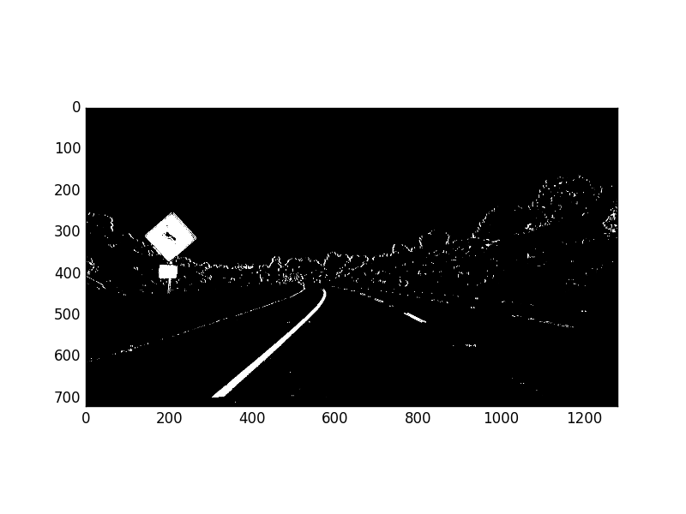
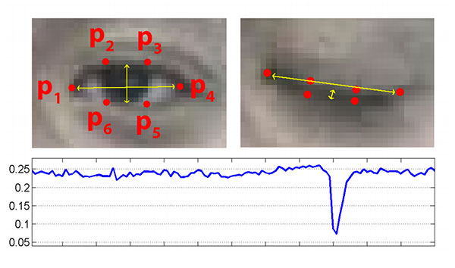
Expected outcome
To provide safety and avoid accidents by detecting road lanes
Monitor Driver facial expression and alerts driver
Detect lanes using above discussed techniques and algorithms
Detect vehicles which are passing near by our vehicle
Driver Face Analyzer
Canny Edge Detection

Slide 23
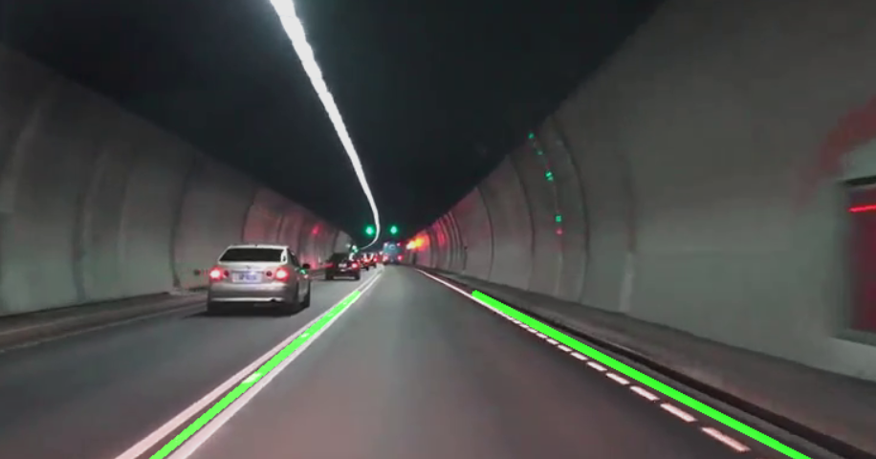
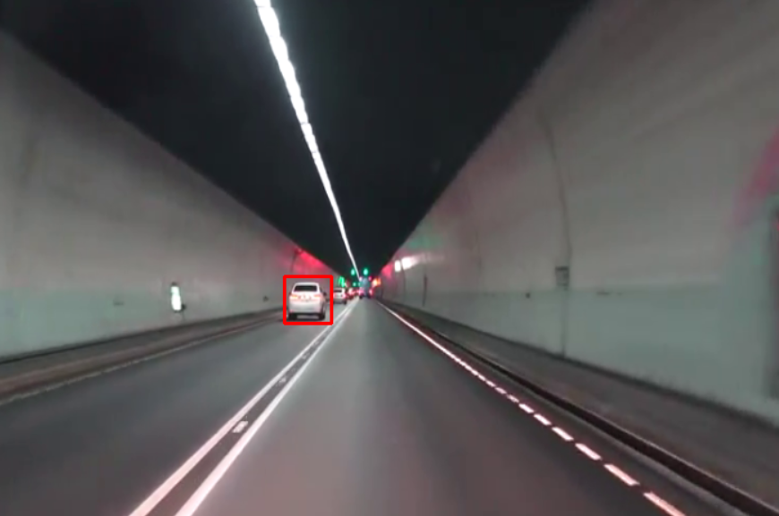
Expected outcome(contd..)
Hough Transform Detection
Vehicle Detection

Slide 24
Comparison
Features | Existed Project | A Lane Detection,Tracking and Recognition System for Smart Vehicles (LTRSV)
SPEED & DISTANCE COVERED | It covers only upto 5 to 30 meters distance in 30KMPH or 70KMPH | It covers upto 5 to 50 meters distance in 30KMPH or 70KMPH
DROWSINESS & VEHICLE DETECTION | Its doesn't have Drowsiness detetction but it have vehicles detection | It have both Drowsiness & Vehicle Detection techniques
VOICE ALERT | It doesn't have voice alert for the driver | It introduced the voice alert system

Slide 25
Plan of action
Task | Starting Date | Ending Date
Literature Survey | 21/11/19 | 5/12/19
Problem statement | 06/12/19 | 12/12/19
Requirements identification | 13/12/19 | 21/12/19
Design | 22/12/19 | 10/01/20
Software Installation | 11/01/20 | 16/01/20
Implementation | 16/01/19 | 28/02/20
Testing | 29/02/20 | 06/03/20
Documentation | 07/03/20 | Not yet completed

Slide 26
References/Bibliography
[1] C. Y. Lin et al., “Real-time mark-on-windshield
warning system for intelligent vehicles,” Transactions of the Canadian Society for Mechanical Engineering, vol.36, no. 1, 2012, pp. 97-112.
[2] A. M.A. Soliman et al., “Fuzzy-skyhook control for active suspension systems applied to a full vehicle
model,” International Journal of Engineering and
Technology Innovation, vol. 2, no. 2, 2012, pp. 85-96.
[3] Y. He et al., “Color-based road detection in urban
traffic scenes,” IEEE Transaction on Intelligent
Transportation System, vol. 5, no. 4, 2004, pp. 309-318.
[4] D. J. Kang and M. H. Jung, “Road lane segmentation using dynamic programming for active safety vehicles,” Pattern Recognition Letters, vol. ,no. 16, 2003, pp.3177-3185.
[5] N. Benmansour et al., “Stereovision-based 3D lane
detection system: a model driven approach,” 11th
International IEEE Conference on Intelligent
Transportation System, Beijing, China, 2008, pp. 182-188.
[6] A. Assidiq et al., “Real time lane detection for
autonomous vehicles,” International Conference on
Computer and Communication Engineering, Kuala
Lumpur, Malaysia, 2008, pp. 82-88.
[7] M. Bahgat, “A simple implementation for unmarked road tracking,” The 14th IEEE Mediterranean Electrotechnical Conference, Ajaccio, France, 2008, pp.929-934.
[8] A. Borkar et al., “A layered approach to robust lane
detection at night,” IEEE Workshop on Computational
Intelligence in Vehicles and Vehicular Systems, Nashville ,TN, U.S., 2009, pp. 51-57.
[9] B. F. Wu et al., “A new vehicle detection with
distance estimation for lane change warning systems,”
Intelligent Vehicles Symposium, Istanbul, Turkey, 2007,pp. 698-703.

Slide 27
THANK YOU

